Slide 1
Variables
Concepts that are observable and measurable
Have a dimension that can vary
Narrow in meaning
Examples:
Color classification
Loudness
Level of satisfaction/agreement
Amount of time spent
Media choice

Slide 2
Types and forms of variables
Variable Types:
Independent – those that are systematically varied by the researcher
Dependent – those that are observed. Their values are resumed to depend on the effects of the independent variables
Variable Forms:
Discrete – only includes a finite set of values (yes/no; republican/democrat; satisfied….not satisfied, etc.)
Continuous – takes on any value on a continuous scale (height, weight, length, time, etc.)

Slide 3
Measures of Central Tendency (Data summarization)
Mean - arithmetic average
µ, Population; x , sample
Median - midpoint of the distribution
Mode - the value that occurs most often

Slide 4
Mode Example
Find the score that occurs most frequently
98
88
81
74
72
72
70
69
65
52
Mode = 72

Slide 5
Median Example
Arrange in descending order and find the midpoint
Odd Number (N = 9)
Even Number (N = 10)
98
88
81
74
72
70
69
65
52
98
88
81
74
72
71
70
69
65
52
Midpoint = 72
Midpoint =
(72+71)/2
= 71.5

Slide 6
Different means
Arithmetic Mean - the sum of all of the list divided by the number of items in the list

Slide 7
Arithmetic Mean Example
98
88
81
74
72
72
70
69
65
52
741\10 = 74.1
741

Slide 8
Measures of Dispersion or Spread
Range
Variance
Standard deviation

Slide 9
The Range as a Measure of Spread
The range is the distance between the smallest and the largest value in the set.
Range = largest value – smallest value
Group 1
Group 2
100, 100
99, 98
88, 77
72, 68
67, 52
43, 42
91, 85
81, 79
78, 77
73, 75
72, 70
65, 60
Range G1: 100 – 42 = 58
Range G2: 91 – 60 = 31

Slide 10
population Variance

Slide 11
Sample Variance

Slide 12
Variance
A method of describing variation in a set of scores
The higher the variance, the greater the variability and/or spread of scores

Slide 13
Variance Example
X
X
X - X
X –X²
98
88
81
74
72
72
70
69
65
52
74.1 =
74.1 =
74.1 =
74.1 =
74.1 =
74.1 =
74.1 =
74.1 =
74.1 =
74.1 =
23.90 = 571.21
13.90 = 193.21
6.90 = 47.61
-0.10 = 0.01
-2.10 = 4.41
-2.10 = 4.41
-4.10 = 16.81
-5.10 = 26.01
-9.10 = 82.81
-22.10 = 488.41
Population Variance (N)
1,434.90 \ 10 = 143.49
Sample Variance (n-1)
1,434.90 \ 9 = 159.43
Mean = 74.1
1,434.90

Slide 14
Uses of the variance
The variance is used in many higher-order calculations including:
T-test
Analysis of Variance (ANOVA)
Regression
A variance value of zero indicates that all values within a set of numbers are identical
All variances that are non-zero will be positive numbers. A large variance indicates that numbers in the set are far from the mean and each other, while a small variance indicates the opposite.

Slide 15
Standard Deviation
Another method of describing variation in a set of scores
The higher the standard deviation, the greater the variability and/or spread of scores

Slide 16
Types of data presentation

Slide 17
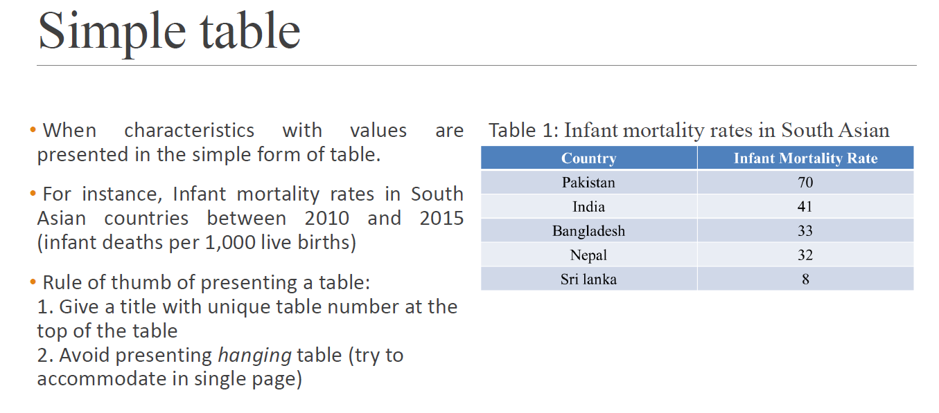
data presentation

Slide 18
data presentation

Slide 19
data presentation

Slide 20
data presentation

